Slide 1
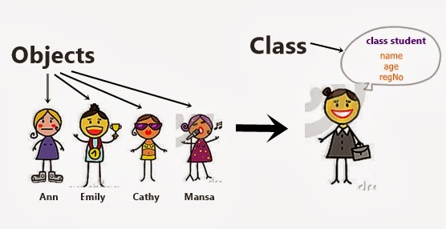
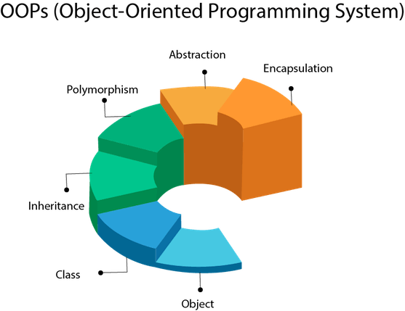
JAVA
Notes:
https://www.softwaretestingmaterial.com/selenium-interview-questions/

Slide 2
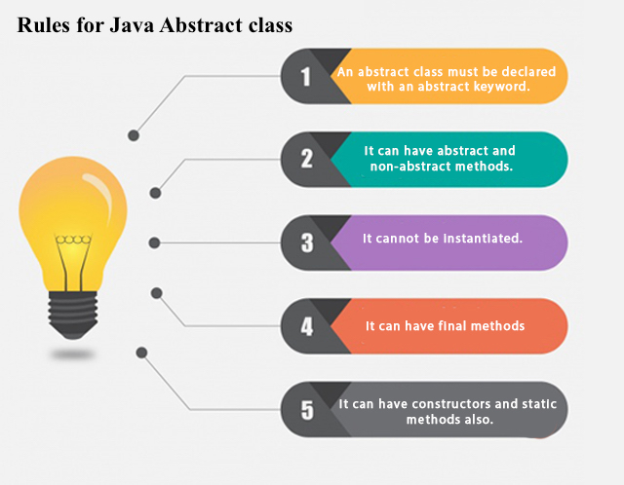
JAVA CLASS
Notes:
https://www.softwaretestingmaterial.com/selenium-interview-questions/

Slide 3
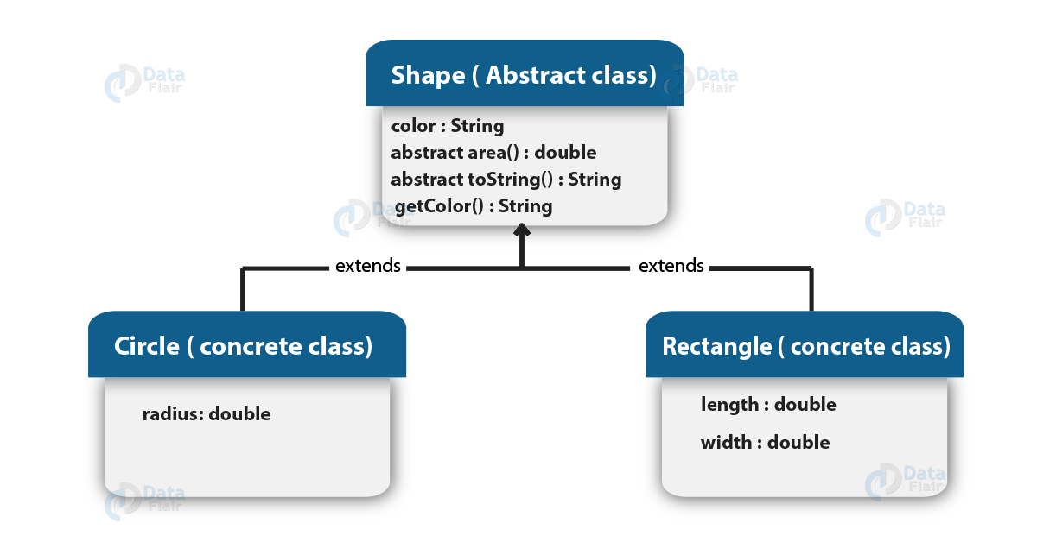
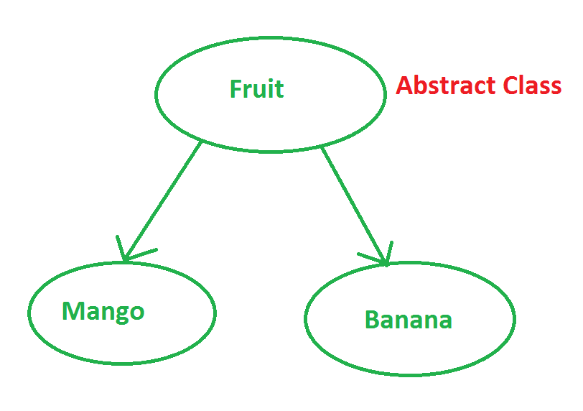
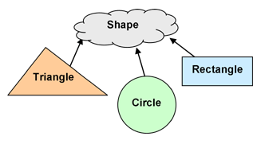
Abstraction
Abstraction means using simple things to represent complexity.

Slide 4
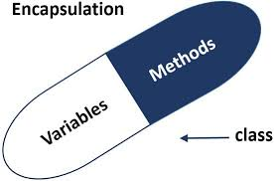
Encapsulation
This is the practice of keeping fields within a class private, then providing access to them via public methods

Slide 5
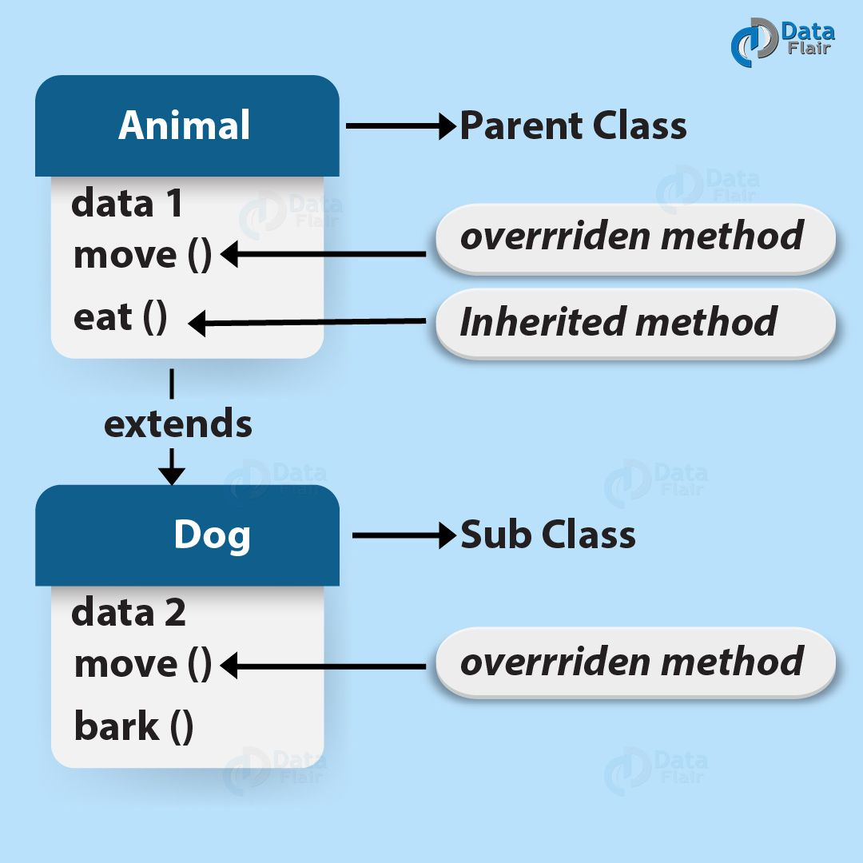
Inheritance
It lets programmers create new classes that share some of the attributes of existing classes.

Slide 6
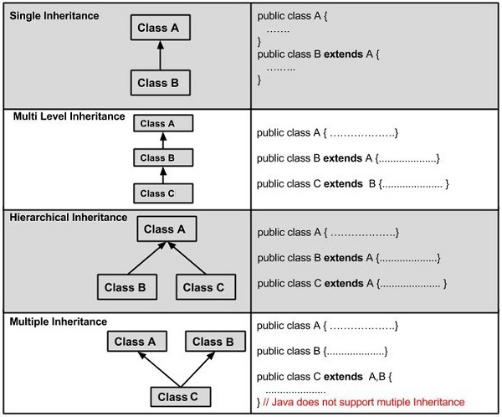
Inheritance
It lets programmers create new classes that share some of the attributes of existing classes.

Slide 7
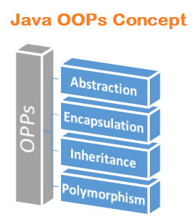
Polymorphism
This Java OOP concept lets programmers use the same word to mean different things in different contexts.

Slide 8
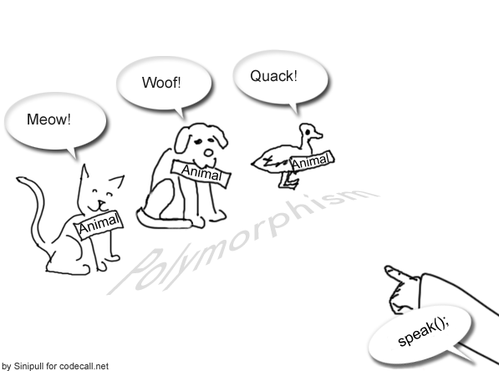
Polymorphism
Method overloading Virtual function
Operator overloading method overriding
Static or Compile Time
Dynamic or Run Time

Slide 9
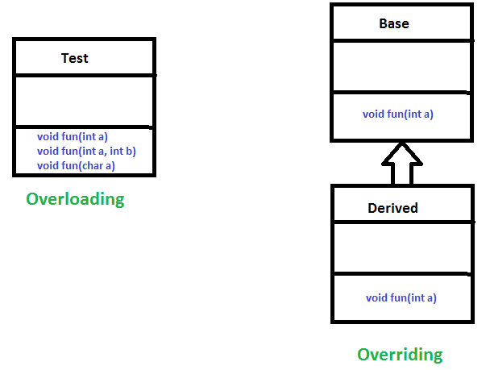
method overloading
a single method name might work in different ways depending on what arguments are passed to it.

Slide 10
method overriding
the child class can use the OOP polymorphism concept to override a method of its parent class.

Slide 11
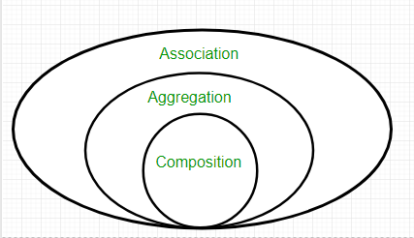
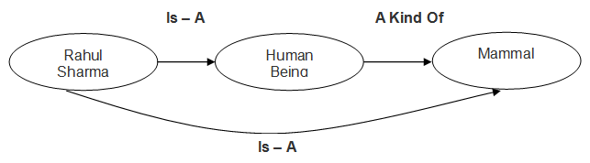
relationship
Notes:
https://www.slideshare.net/AdilAslam4/class-diagram-in-uml

Slide 12
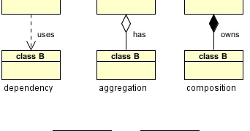
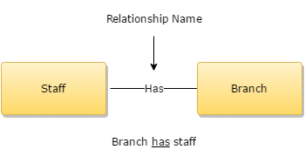
relationship

Slide 13
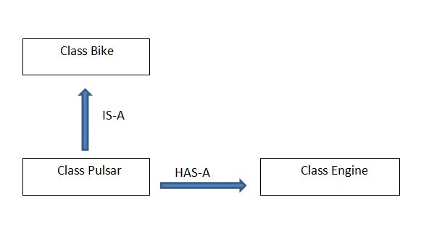
relationship

Slide 14
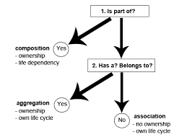
relationship

Slide 15
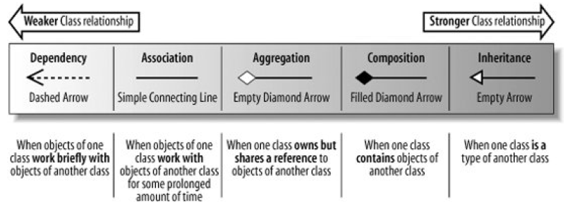
relationship

Slide 16
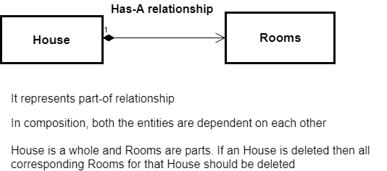
Relationship: Composition

Slide 17
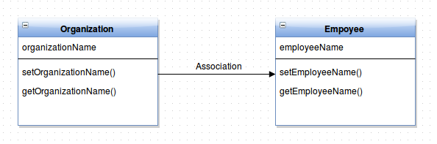
Relationship: Association

Slide 18
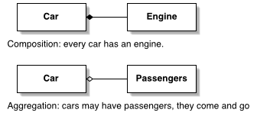
Relationship: aggregation

Slide 19
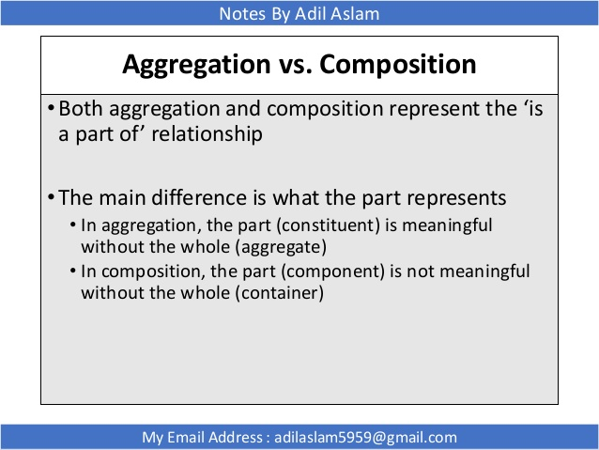
Relationship: aggregation Vs Composition

Slide 20
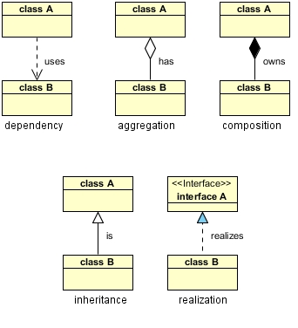
Relationship: UML diagram

Slide 21
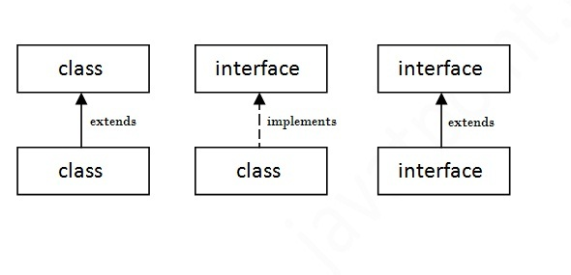
Interface in java

Slide 22
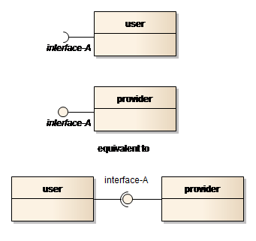
Interface in java

Slide 23
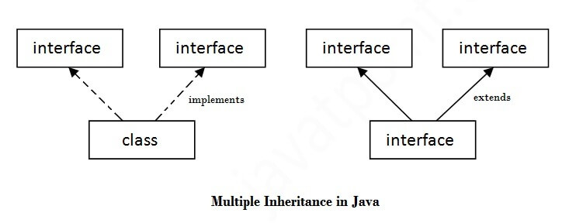
Interface in java

Slide 24
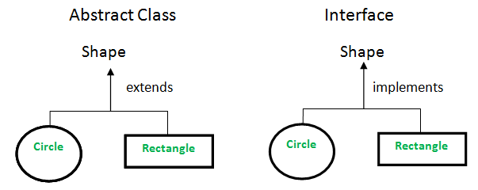
Interface in java

Slide 25
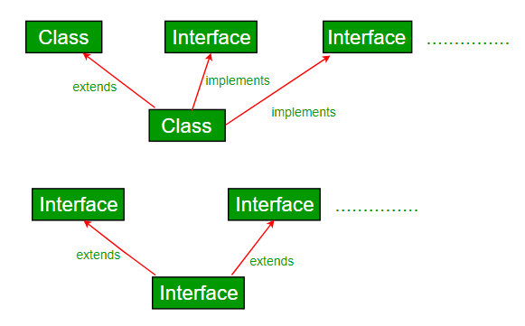
Interface in java

Slide 26
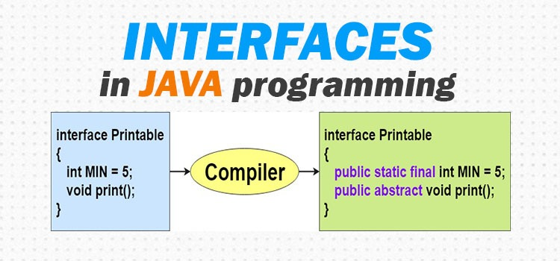
Interface in java

